Slide 1
Python Programming with Google Colab

Slide 2
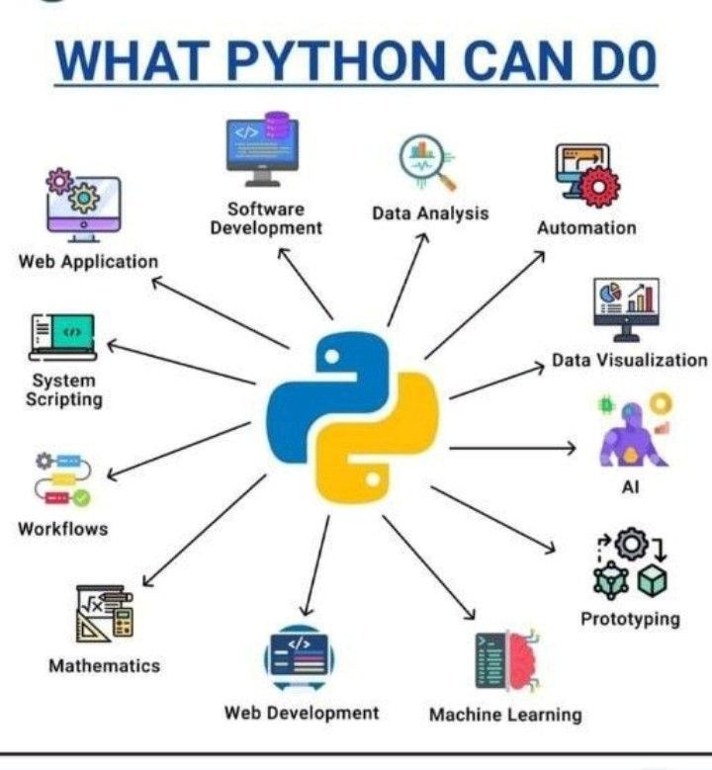
what python can do ? (pinterest.com)

Slide 3

Why use Google Colab(Google Colaboratory)?
Notes:
Google Colab is a jupyter notebook environment. It is a free source provided by google wherein we can write and execute code. We can use Google Colab with ease just as we use local jupyter. Google Colab provides RAM of 12 GB with a maximum extension of 25 GB and a disk space of 358.27 GB. Wow! It is great to have a free source with such huge RAM and disk space.

Slide 4
Why Google Colab?
It has collaboration backed in the product
It run on Google servers
Don't install anything
Notebooks are saved in Google Drive

Slide 5
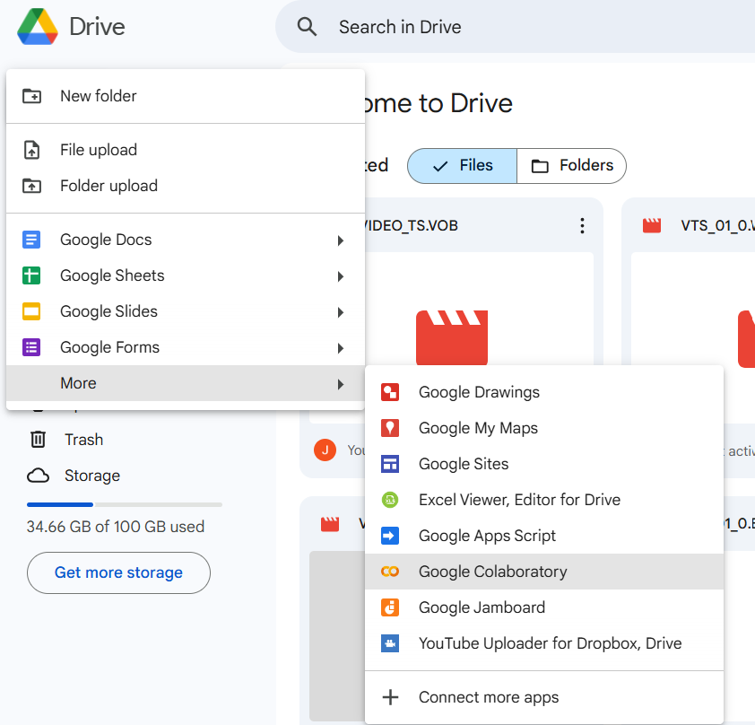
Getting Ready with Google Colab?
Create a New Folder in your Google Drive

Slide 6
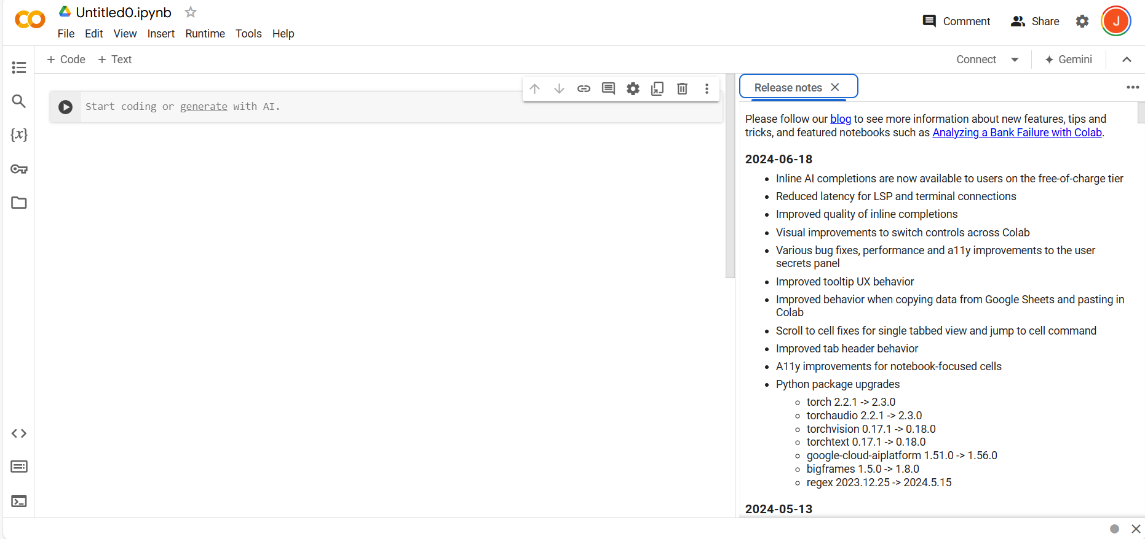
Google Colab Environment
Rename your Notebook

Slide 7
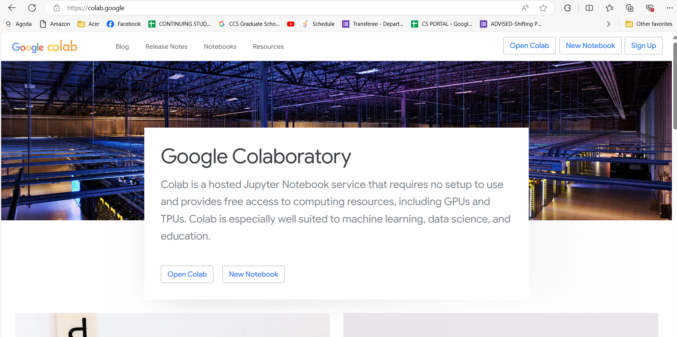

Slide 8
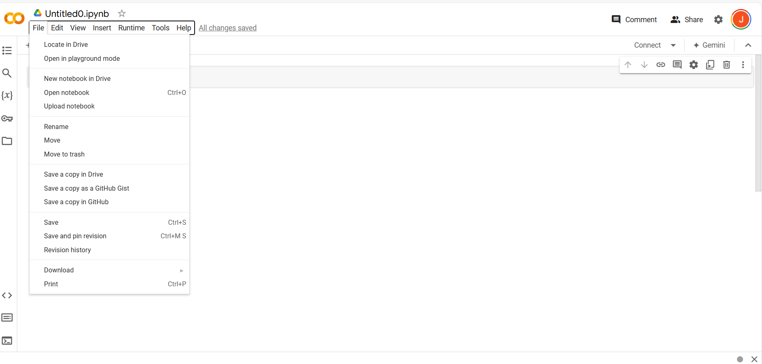

Slide 9
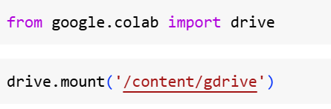
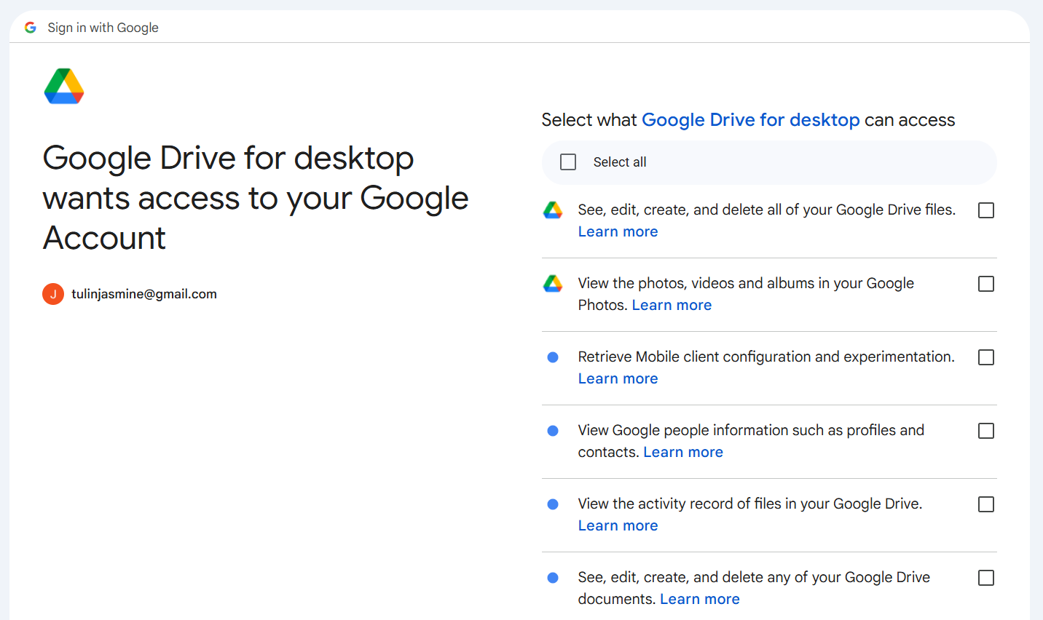
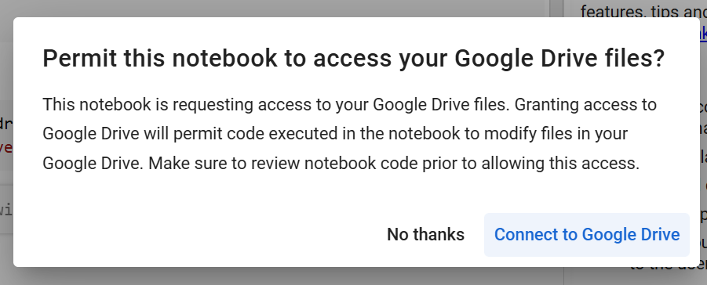
How to open your files in Google Colab?
1
3
x
2

Slide 10
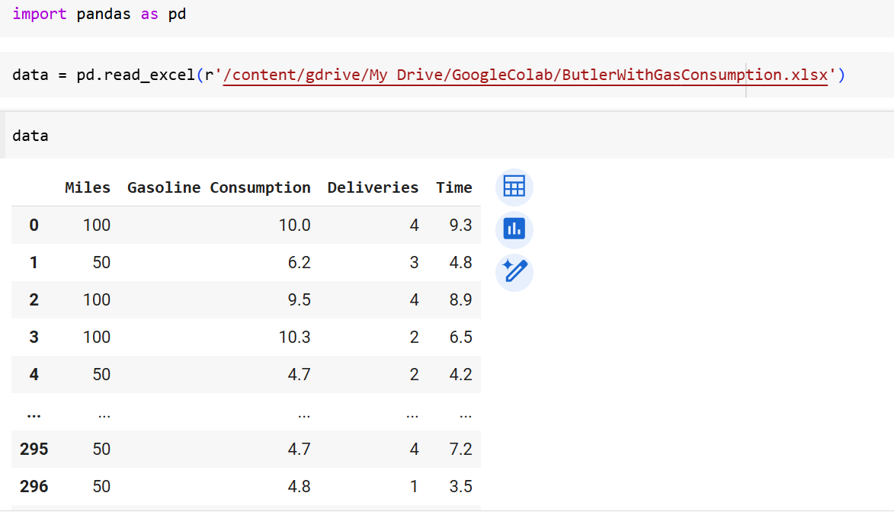
How to open your files in Google Colab?

Slide 11
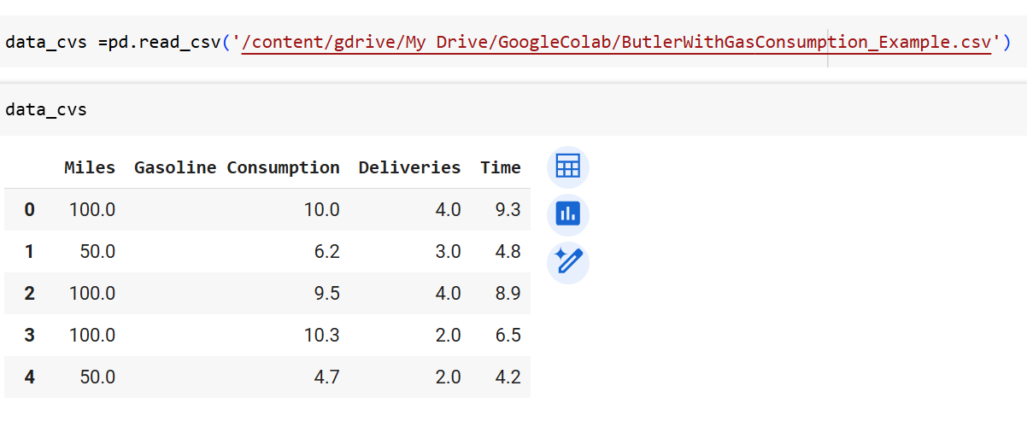

Slide 12
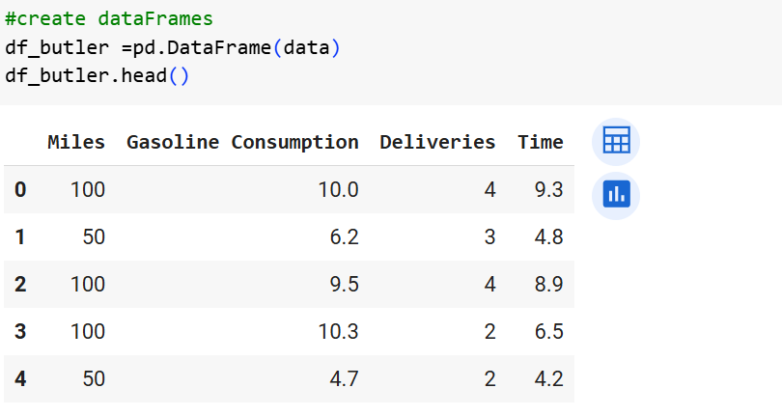
How to create data to DataFrame?

Slide 13
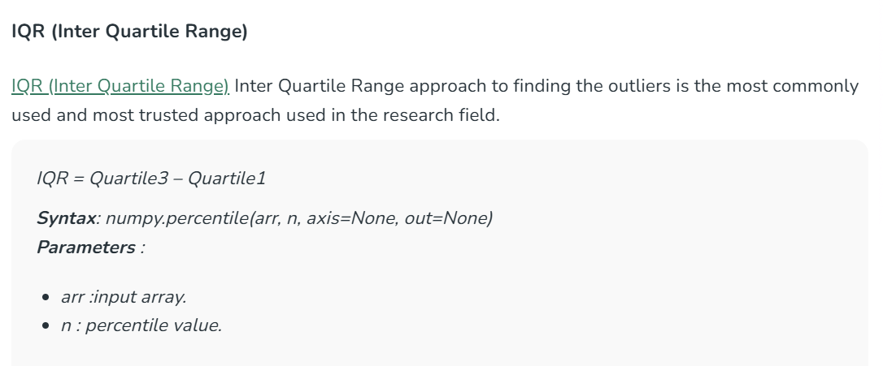
How to remove outliers in Python?

Slide 14
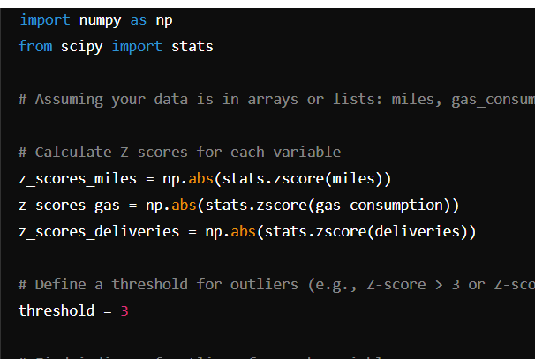
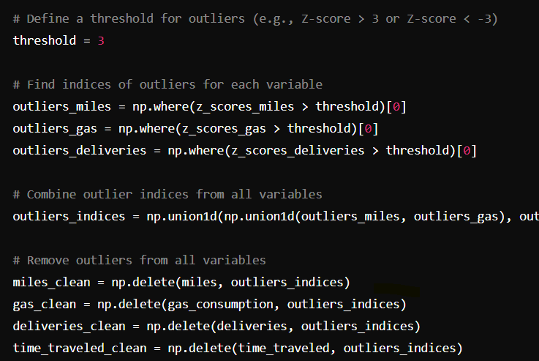

Slide 15
